Slide 1

Chris Blow
Notes:
Hello my name is Chris Blow I am an interaction designer. I work on Meedan and Ushahidi.

Slide 2
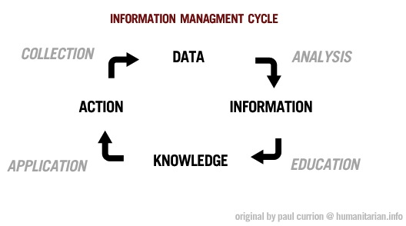
Notes:
I want to talk about information management.

Slide 3
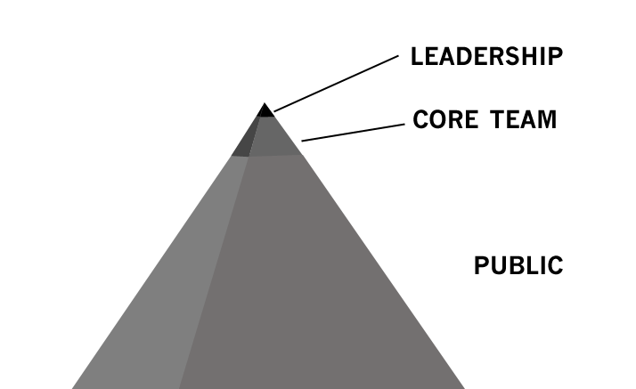
Notes:
For a long time over the last two years I have drawn this pyramid. Many of us dream of a broader base of participatory media.

Slide 4
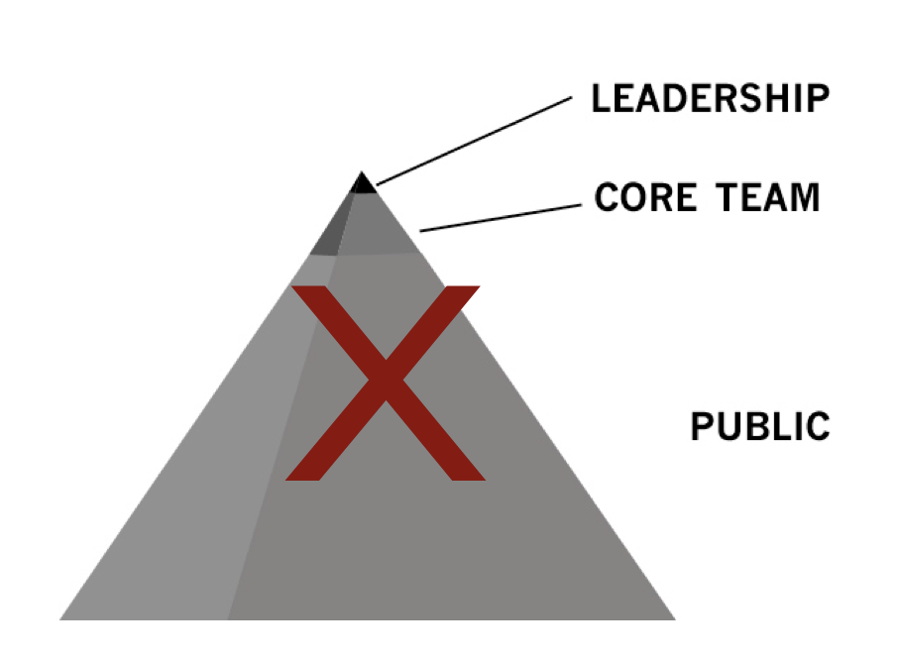
Notes:
But after a while I realized how hierarchical it is – and that doesn’t match my experience on these projects at all.

Slide 5
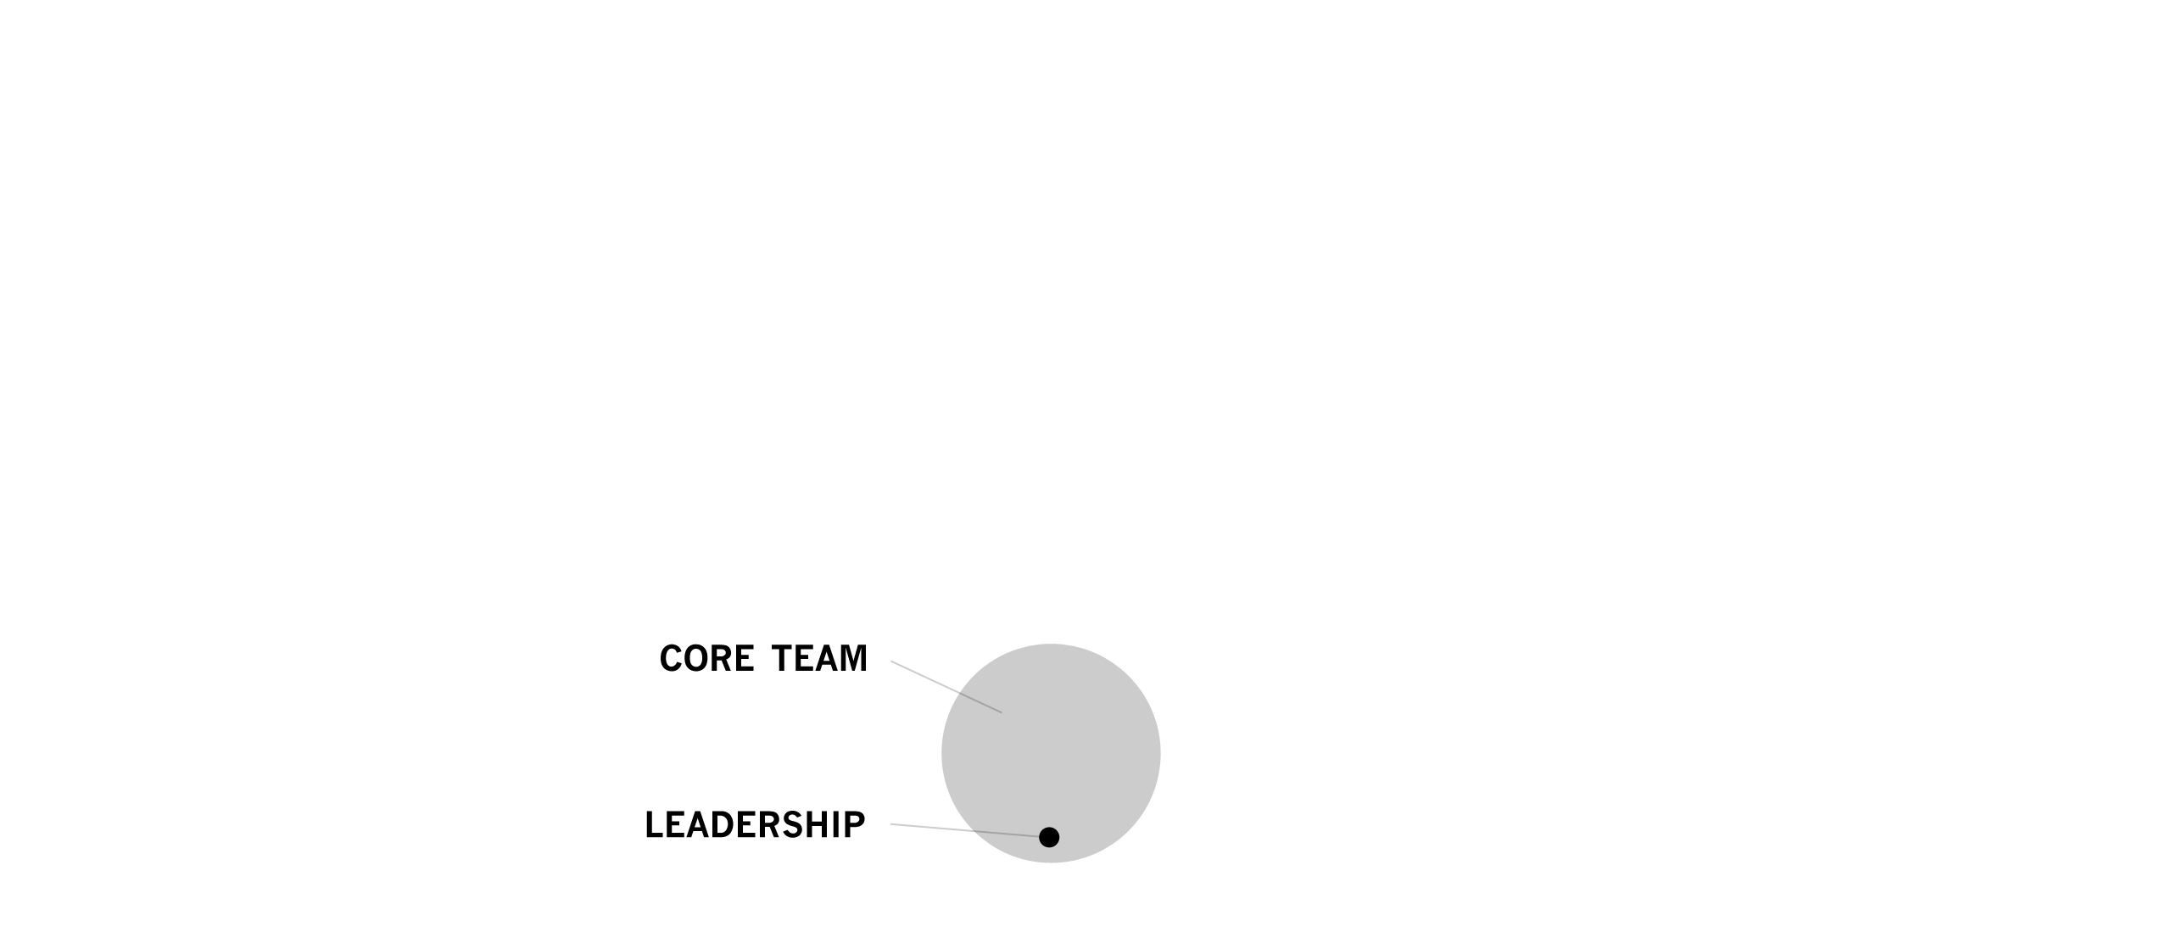
Notes:
Usually, it’s more like this. It’s democratic. Small, functional.

Slide 6
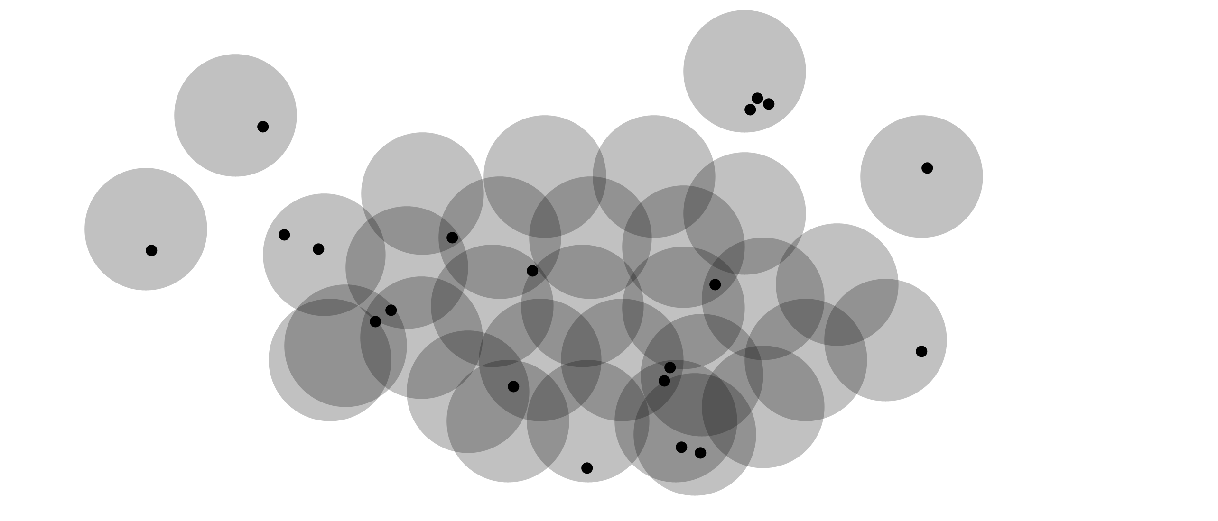
Notes:
During the Haiti experience, this was what I saw more of.

Slide 7
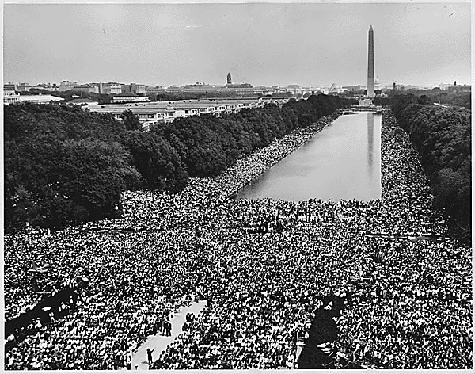
Notes:
I am interested in understanding how other social movements developed. The Civil Rights Movement led to the successful passage of the Civil Rights Act.

Slide 8
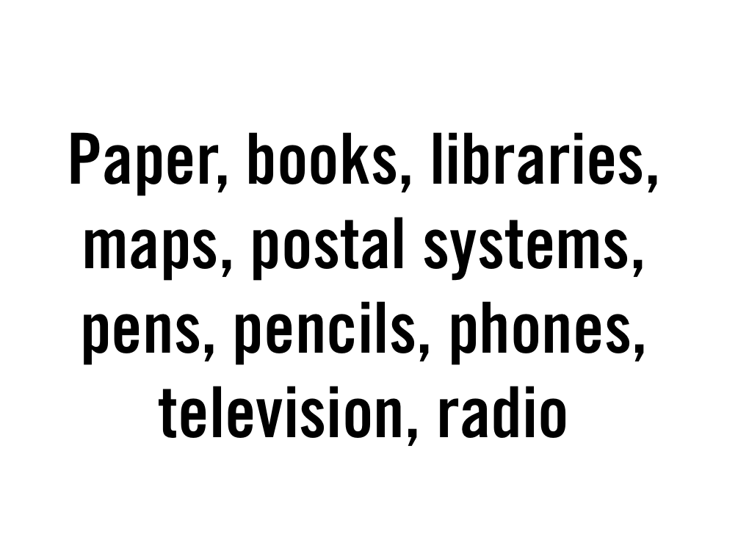
Notes:
The tools that they used for networking were so basic.

Slide 9
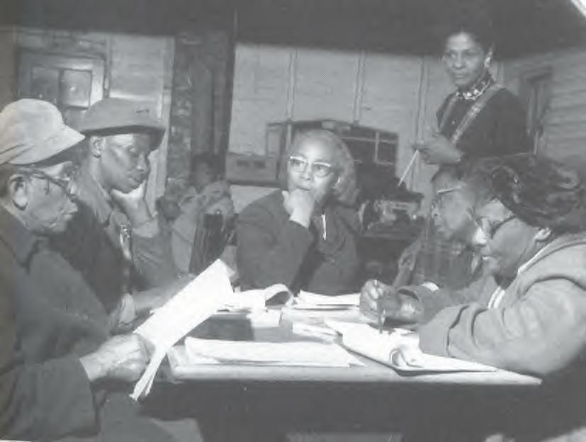
Notes:
But there was an aspect of collaboration and civic activism which was strong enough to achieve major social goals.

Slide 10
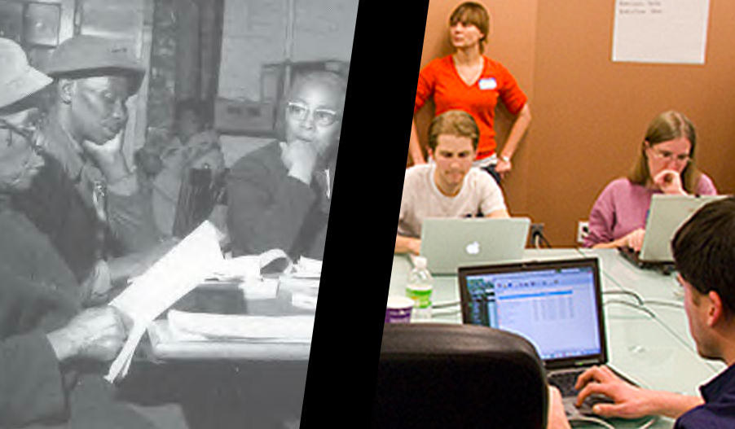
Notes:
I would like to interject that into our existing work.

Slide 11
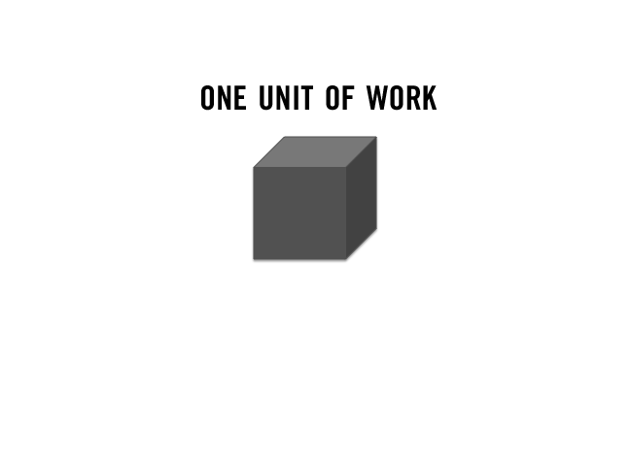
Notes:
I have a box here today that contains every report from the Ushahidi Haiti instance. It contains 24 volumes of reports.

Slide 12
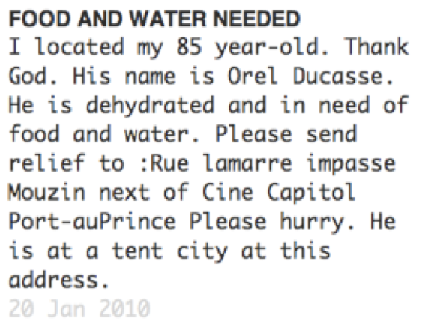
Notes:
The reports are heartbreaking.

Slide 13
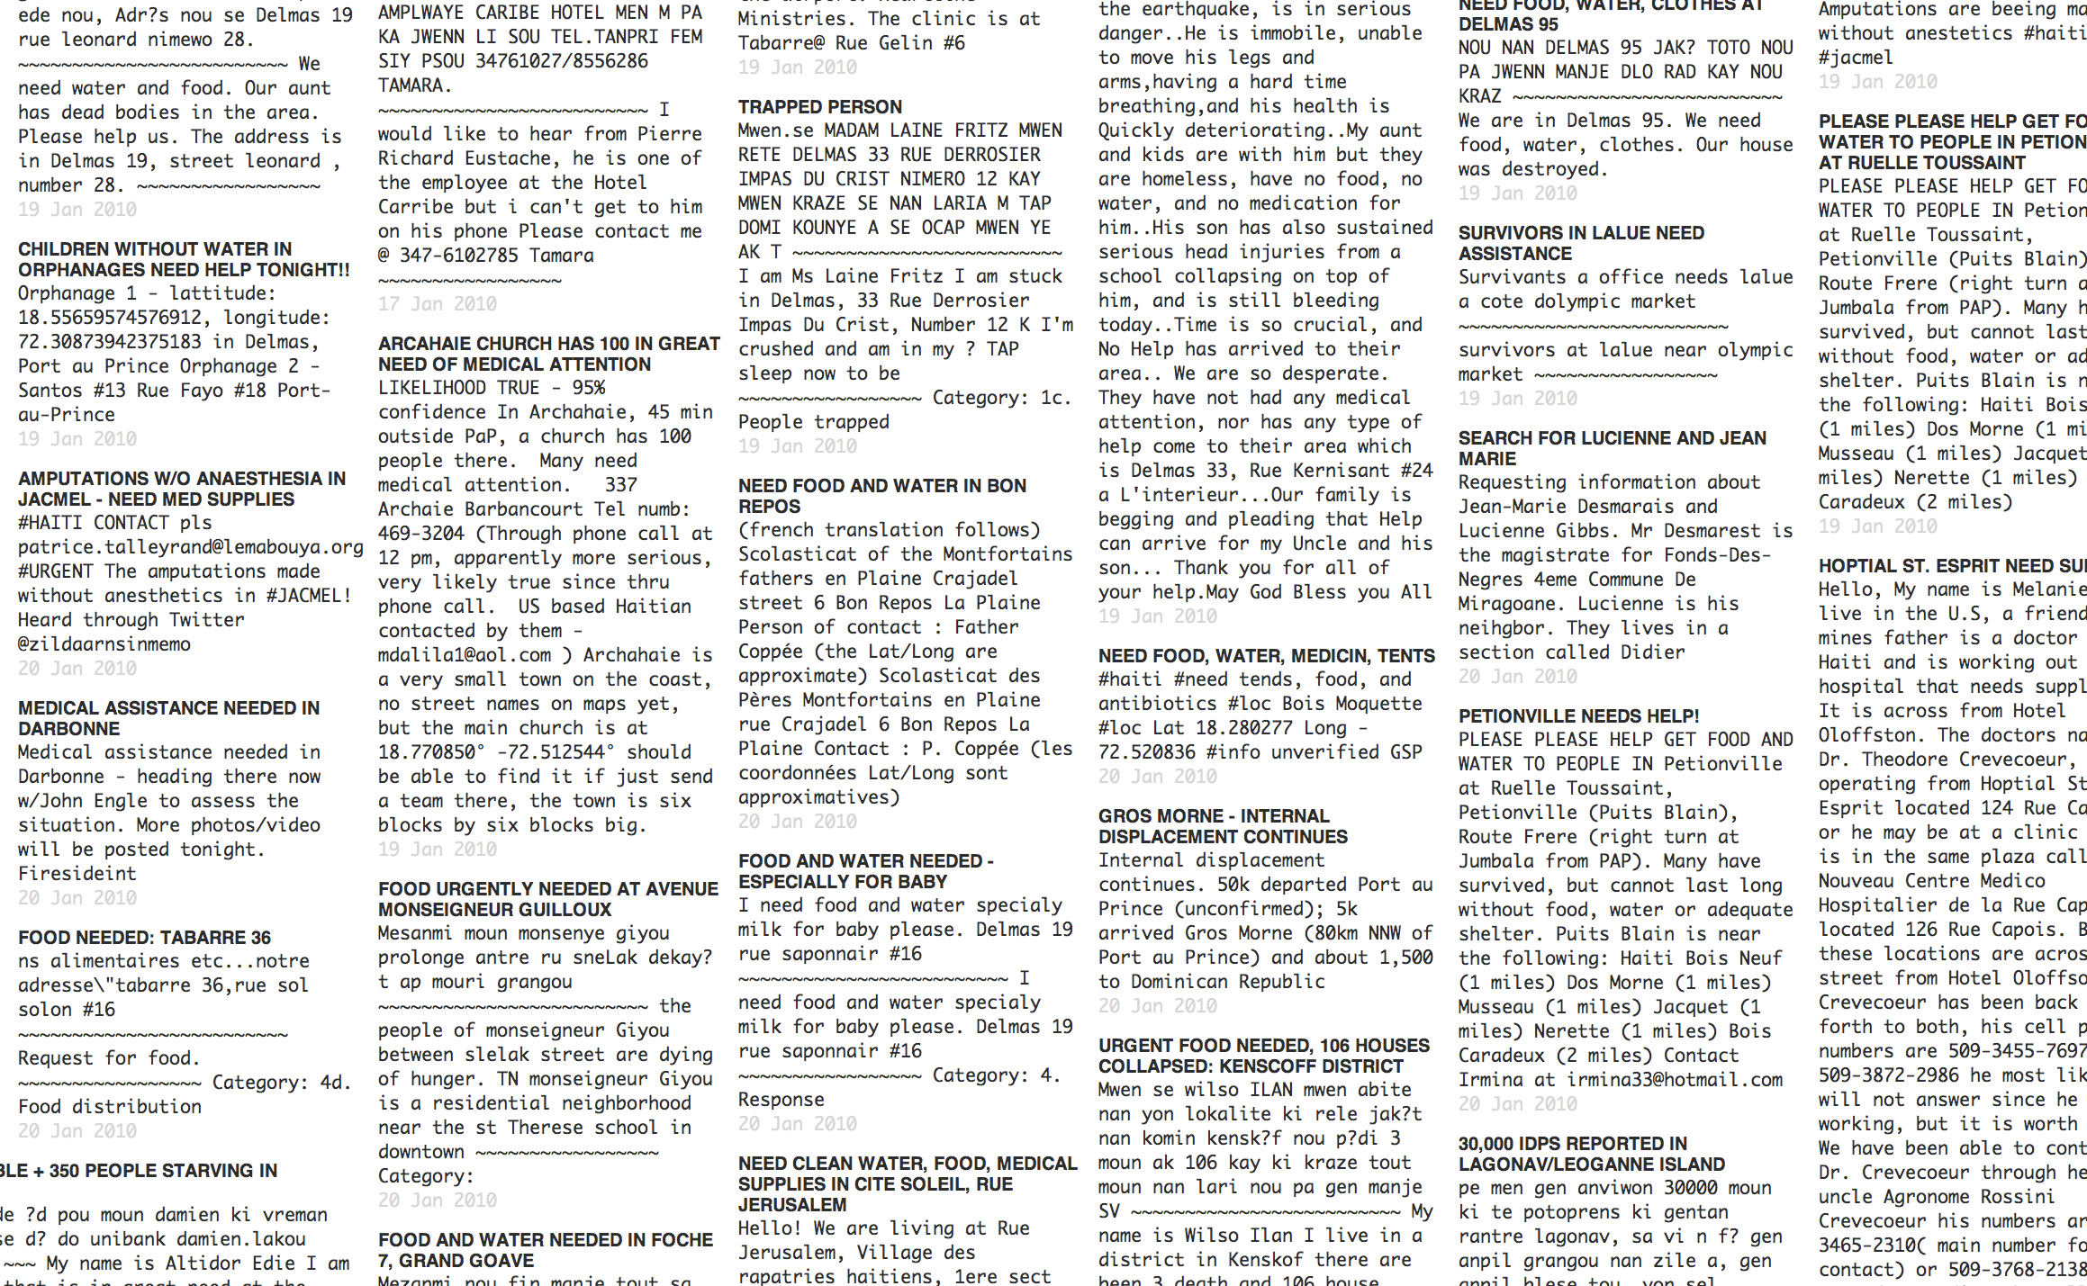
Notes:
The reports are not pretty. They are artifacts of one of our earliest attempts to move data fluidly under extreme conditions.

Slide 14
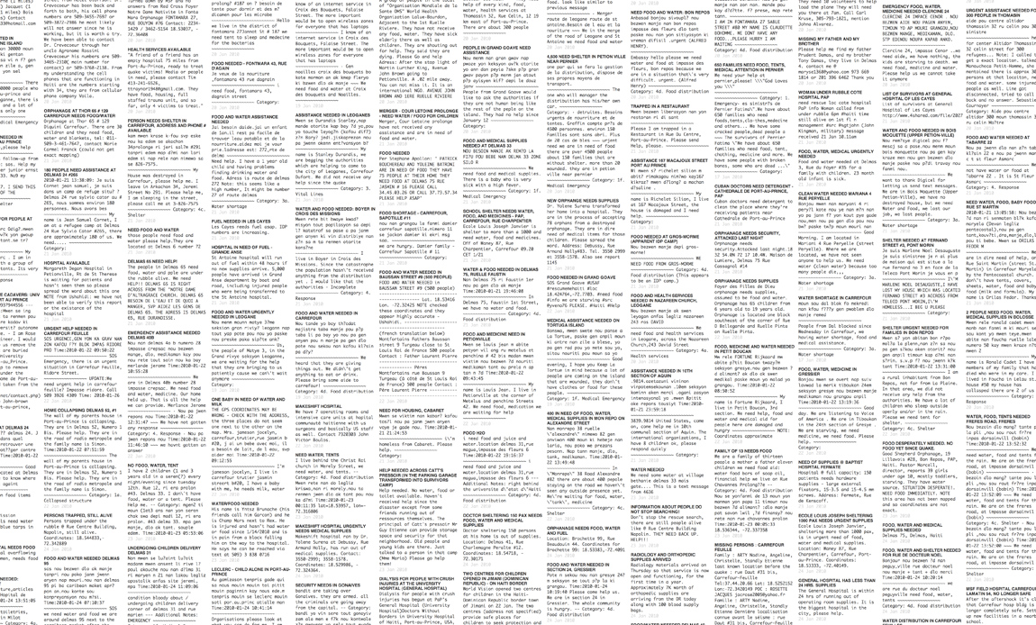

Slide 15

Notes:
The reports were translated, verified, geolocated, and categorized.

Slide 16
Notes:
So: let’s call this one unit of work.

Slide 17


Slide 20
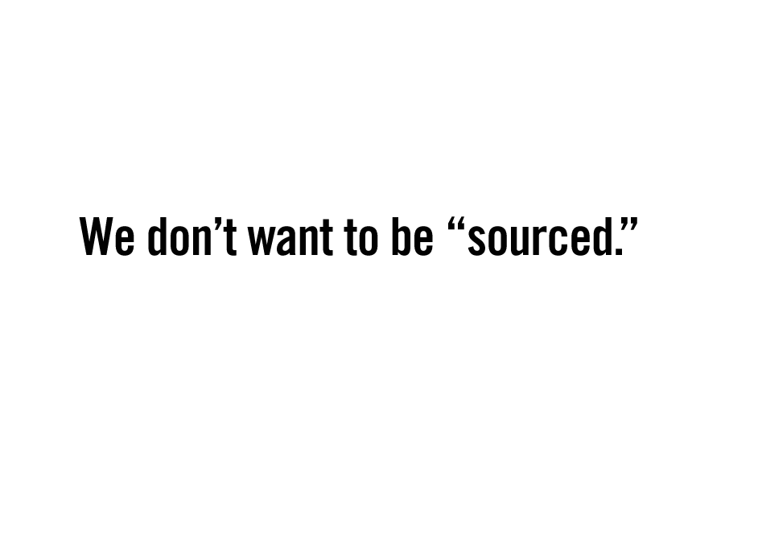
Notes:
I am repeatedly frustrated by the attitude that many organizations take toward the agents of social change.

